Slide 1
Multivibrator
A multivibrator is an electronic circuit that can exist in a number of “states”
The three types of multivibrator circuits are
Astable multivibrator, in which the circuit is not stable in either state —it continually switches from one state to the other. It functions as a relaxation oscillator.

Slide 2
Monostable multivibrator, in which one of the states is stable, but the other state is unstable (transient). A trigger pulse causes the circuit to enter the unstable state. After entering the unstable state, the circuit will return to the stable state after a set time. Such a circuit is useful for creating a timing period of fixed duration in response to some external event. This circuit is also known as a one shot.
Bistable multivibrator, in which the circuit is stable in either state. It can be flipped from one state to the other by an external trigger pulse.

Slide 3
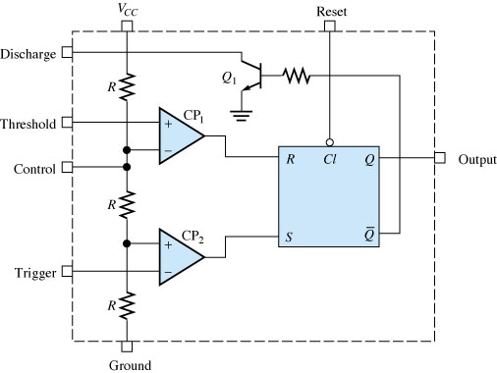
The 555 Timer
The 555 timer analog IC (Integrated Circuit) is very economical and convenient for use in mutivibrator circuits since few external components are required.

Slide 4
The 555 timer IC has two comparator, one SR flip-flop and one switching BJT transistor.
Power supply voltage Vcc is applied to a series of three resistors so that almost 1/3Vcc and 2/3Vcc is established.
The reset, threshold and trigger control the state of the flip-flop. If reset is low, Q output is low regardless of the input applied, and transistor is saturated in this case. So, reset has the highest priority in setting Q. When reset is high (connected to Vcc) it does not affect the output Q.
If the trigger input is lower than 1/3Vcc, then the comparator output is high, setting Q to high and transistor is off.
If the threshold input becomes higher than 2/3Vcc, then the output of the comparator is high, resetting Q to low and transistor is in saturation.

Slide 5
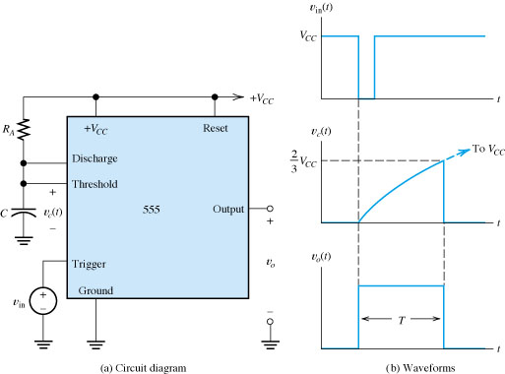
The 555 Monostable Multivibrator
A Monostable Multivibrator is a circuit that produces an output pulse of fixed duration each time the input of the circuit is triggered. This is useful in producing timing signals.
The pulse width can be calculated as
T= 1.1 R_{A}.C.

Slide 6
Pulse Width Derivation
We know that the voltage across the capacitor C rises exponentially. Hence the equation for the capacitor voltage V_{C} can be written as
V_{C} = V_{CC} (1 – e^{-t/RC})
When the capacitor voltage is 2/3 V_{CC}, then
2/3 V_{CC} = V_{CC} (1 – e^{-t/RC})
2/3 = 1 – e^{-t/RC}
e^{-t/RC} = 1/3
– t/RC = ln (1/3)
– t/RC = -1.098
t = 1.098 RC
∴ t ≈ 1.1 RC
The pulse width of the output rectangular pulse is T = 1.1 RC.

Slide 7
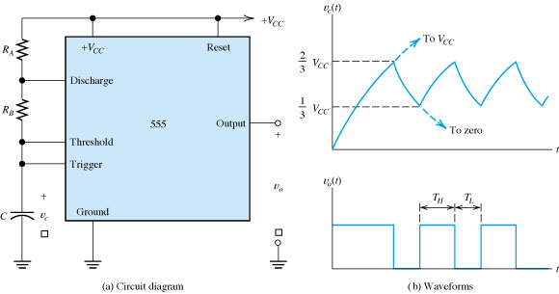
The 555 Astable Multivibrator
An Astable Multivibrator can be formed by adding two resistors and a capacitor to the 555 timer.

Slide 8
Initially, when the power is turned on, the capacitor is uncharged and thus the trigger voltage (pin 2) is at 0 V. This causes the output of the lower comparator to be high and the output of the upper comparator to be low, forcing the output of the flip-flop, and thus the base of Q₁ low and keeping the transistor off. Now, begins C charging through R_{A} and R_{B}. When the capacitor voltage reaches 1⁄3VCC, the lower
comparator switches to its low output state, and when the capacitor voltage reaches 2⁄3VCC, the upper comparator switches to its high output state. This resets the flip-flop, causes the Base of Q₁ to go high, and turns on the transistor. This sequence creates a discharge path for the capacitor through R_{B} and the transistor, as indicated. The capacitor now begins to discharge, causing the upper comparator to go low. At the point where the capacitor discharges down to 1⁄3VCC, the lower comparator switches high, setting the flip-flop, which
makes the base of Q₁ low and turns off the transistor. Another charging cycle begins, and the entire process repeats. The result is a rectangular wave output whose duty cycle depends on the values of R_{A} and R_{B}.

Slide 9
Therefore,
the frequency of oscillation and duty cycle are
f_{osc} = 1/ T_{osc} = 1.44/(R_{A} + 2R_{B}).C
Duty Cycle = {T_{H} /T}100%
={(R_{A} + R_{B}) / (R_{A} + 2R_{B})}100%

